Slide 1

LINQ Overview
LINQ and Lambda Expressions
LINQ Overview
Telerik Academy Plus
http://academy.telerik.com

Slide 2

Table of Contents
Lambda Expressions
Anonymous functions
Creating Lambda expressions
Action and Func
LINQ Queries
Extension methods
Operations with collections

Slide 3
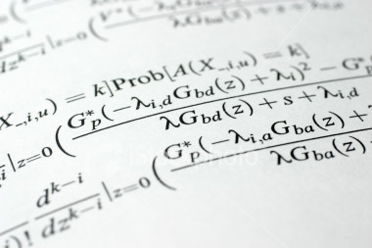
Lambda Expressions

Slide 4
Lambda Expressions
A lambda expression is an anonymous function containing expressions and statements
Used to create delegates or expression tree types
Lambda expressions
Use the lambda operator =>
Read as "goes to"
The left side specifies the input parameters
The right side holds the expression or statement

Slide 5
Lambda Expressions – Examples
Usually used with collection extension methods like FindAll() and RemoveAll()
List<int> list = new List<int>() { 1, 2, 3, 4 };
List<int> evenNumbers =
list.FindAll(x => (x % 2) == 0);
foreach (var num in evenNumbers)
{
Console.Write("{0} ", num);
}
Console.WriteLine();
// 2 4
list.RemoveAll(x => x > 3); // 1 2 3

Slide 6
Sorting with Lambda Expression
var pets = new
{
"Sharo", "Rex", "Strela", "Bora"
};
var sortedPets = pets.OrderBy(pet => pet);
foreach (Pet pet in sortedPets)
{
Console.WriteLine("{0}", pet);
}

Slide 7
Lambda Code Expressions
Lambda code expressions:
List<int> list = new List<int>()
{ 20, 1, 4, 8, 9, 44 };
// Process each argument with code statements
List<int> evenNumbers = list.FindAll((i) =>
{
Console.WriteLine("value of i is: {0}", i);
return (i % 2) == 0;
});
Console.WriteLine("Here are your even numbers:");
foreach (int even in evenNumbers)
Console.Write("{0}\t", even);

Slide 8
Delegates Holding Lambda Functions
Lambda functions can be stored in variables of type delegate
Delegates are typed references to functions
Standard function delegates in .NET:
Func<TResult>, Func<T, TResult>, Func<T1, T2, TResult>, …
Func<bool> boolFunc = () => true;
Func<int, bool> intFunc = (x) => x < 10;
if (boolFunc() && intFunc(5))
Console.WriteLine("5 < 10");

Slide 9
Delegates – Example
List<string> towns = new List<string>()
{
"Sofia", "Plovdiv", "Varna", "Sopot", "Silistra"
};
List<string> townsWithS =
towns.FindAll(delegate(string town)
{
return town.StartsWith("S");
});
// A short form of the above (with lambda expression)
List<string> townsWithS =
towns.FindAll((town) => town.StartsWith("S"));
foreach (string town in townsWithS)
{
Console.WriteLine(town);
}

Slide 10

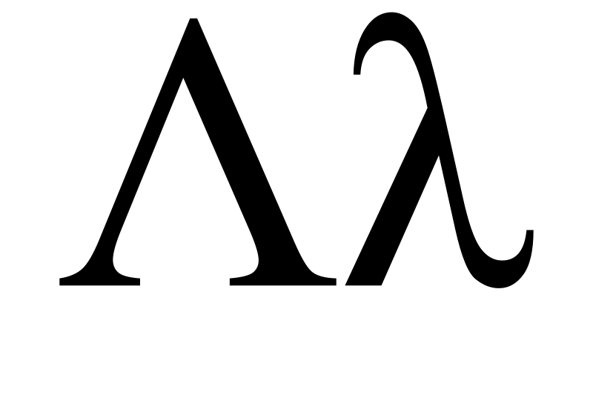
Lambda Expressions
Live Demo

Slide 11
Action<T> and Func<T>
Action<T> - void delegate with parameter T
Func<T, TResult> - result delegate returning T
Action<int> act = (number) =>
{
Console.WrileLine(number); }
act(10); // logs 10
Func<string, int, string> greet = (name, age) =>
{
return "Name: " + name + "Age: " + age;
}
Console.WriteLine(greet("Ivaylo", 10));

Slide 12

Action<T> and Func<T>
Live Demo

Slide 13



LINQ and Query Keywords
LINQ

Slide 14
LINQ Building Blocks (2)
LINQ is a set of extensions to .NET Framework
Encompasses language-integrated query, set, and transform operations
Consistent manner to obtain and manipulate "data" in the broad sense of the term
Query expressions can be defined directly within the C# programming language
Used to interact with numerous data types
Converted to expression trees at compile time and evaluated at runtime

Slide 15





LINQ to *
C#
VB.NET
Others …
.NET Language-Integrated Query (LINQ)
LINQ enabled data sources
LINQ enabled ADO.NET
LINQ to Objects
LINQ to DataSets
LINQ
to SQL
LINQ to
Entities
LINQ
to XML
<book>
<title/>
<author/>
<price/>
</book>
Objects
Relational Data
XML

Slide 16
Standard Query Operators – Example
string[] games = {"Morrowind", "BioShock","Half Life",
"The Darkness","Daxter", "System Shock 2"};
// Build a query expression using extension methods
// granted to the Array via the Enumerable type
var subset = games.Where(game => game.Length > 6).
OrderBy(game => game).Select(game => game);
foreach (var game in subset)
Console.WriteLine(game);
Console.WriteLine();

Slide 17
Querying Generic Lists
The previous example can be adapted to work with a generic list
List<T>, LinkedList<T>, Queue<T>, Stack<T>, HashSet<T>, etc.
List<string> books = new List<string>() {
"LINQ in Action",
"LINQ for Fun",
"Extreme LINQ" };
var titles = books
.Where(book => book.Contains("Action"));

Slide 18
Querying Strings
Although System.String may not be perceived as a collection at first sight
It actually is a collection, because it implements IEnumerable<char>
String objects can be queried with LINQ to Objects, like any other collection
var count = "Non-letter characters in this string: 8"
.Where(c => !Char.IsLetter(c))
.Count();
Console.WriteLine(count);
// The result is: 8

Slide 19
Operations
Where()
Searches by given condition
First()/FirstOrDefault()
Gets the first matched element
Last()/LastOrDefault()
Gets the last matched element
Select()/Cast()
Makes projection (conversion) to another type
OrderBy()/ThenBy()/OrderByDescending()
Orders a collection

Slide 20
Operations
Any()
Checks if any element matches a condition
All()
Checks if all element matches a condition
ToArray()/ToList()/AsEnumerable()
Converts the collection type
Reverse()
Reverses a collection

Slide 21
Aggregation Methods
Average()
Calculates the average value of a collection
Count()
Counts the elements in a collection
Max()
Determines the maximum value in a collection
Sum()
Sums the values in a collection

Slide 22
Aggregation Methods – Examples
Count(<condition>)
Max()
double[] temperatures =
{28.0, 19.5, 32.3, 33.6, 26.5, 29.7};
int highTempCount = temperatures.Count(p => p > 30);
Console.WriteLine(highTempCount);
// The result is: 2
double[] temperatures =
{28.0, 19.5, 32.3, 33.6, 26.5, 29.7};
double maxTemp = temperatures.Max();
Console.WriteLine(maxTemp);
// The result is: 33.6

Slide 23

LINQ Query Keywords
LINQ
Live Demo

Slide 24

Extension Methods, Lambda Expressions and LINQ
Questions?

Slide 25
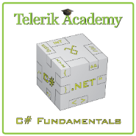



Free Trainings @ Telerik Academy
C# Programming @ Telerik Academy
csharpfundamentals.telerik.com
Telerik Software Academy
academy.telerik.com
Telerik Academy @ Facebook
facebook.com/TelerikAcademy
Telerik Software Academy Forums
forums.academy.telerik.com

